Slide 1
SUSTAINABLE DEVELOPMENT PRACTICES
Delivered by,
Dr. Karthikeyan S,
Assistant Professor (ECE),
Faculty of Engineering & Technology,
SRMIST, Trichy
Course Code: 21EEO306T
Year/Semester: III/V
Department: CSE/ AIML

Slide 2
Unit I: Introduction to Sustainable Development

Slide 3
Course Objective & Outcomes
Objective
Gain a basic understanding on sustainable development
Understand the necessity of social development towards sustainability
Familiarize the integrated strategies of sustainable development
Outcome
Familiarize the necessity of sustainable development by various stake holders
Recognize the feasibility approaches techniques and outcomes of sustainable development
Interpret various policies and integrated approaches for adoption of sustainable development

Slide 4
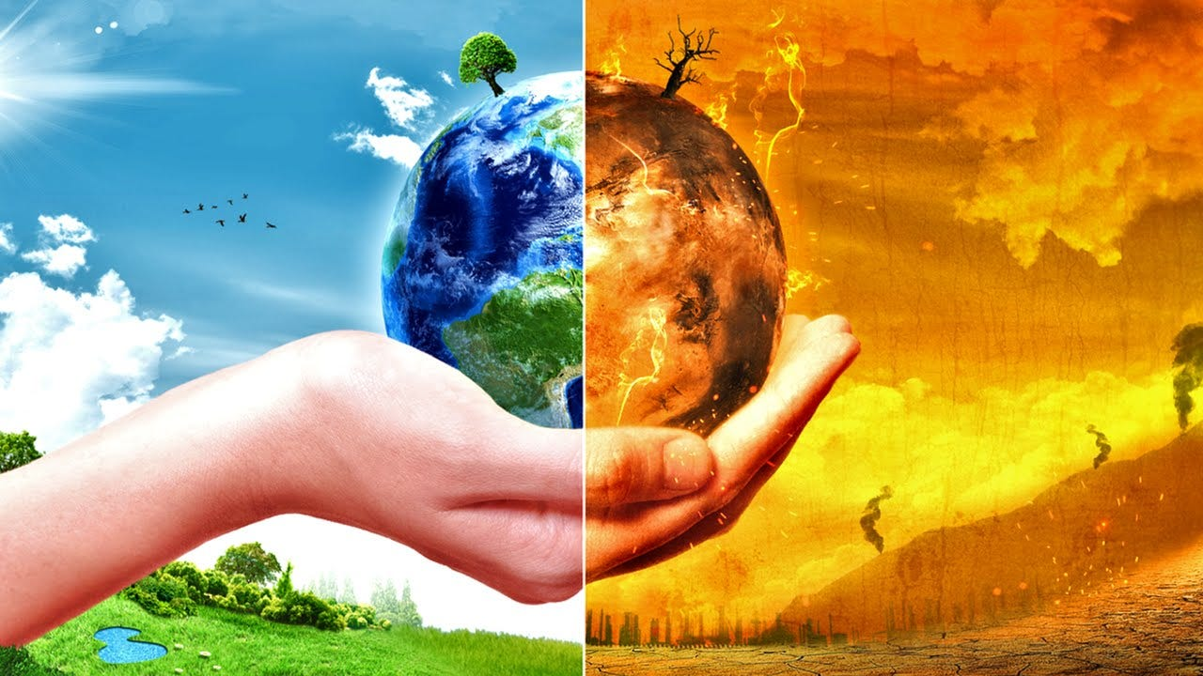
Mother Earth

Slide 5
Mother Earth Should be Revived

Slide 6
Introduction to Sustainable Development
Sustain
To make something continue for a long period of time without becoming less
Sustainable
Involves the use of natural products & energy in a way that does not harm the environment
Sustainable Development
Development that meets the needs of the present without compromising the ability of future generations to meet their own needs

Slide 7
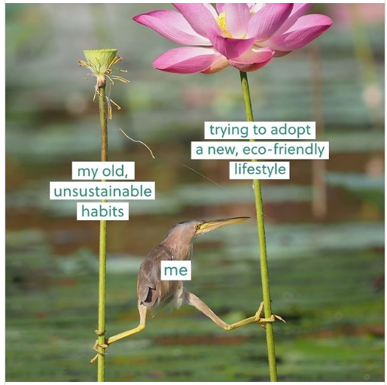

SDP: What it is???
Holistic approach to growth and progress that aims to meet the needs of the present without compromising the ability of future generations to meet their own needs (1987 Bruntland Commission Report, United Nations)
Sustainable development ensuring a healthy planet and a prosperous society for present and future generations

Slide 8
Need for Sustainable Development
Overexploitation of Natural Resources
Scarcity of Resources
Climate Change
Economic Development
Social Equity
Extinction of Species,
Decline in world’s food production,
Decline in Marine Fisheries
Demand for a good or service is greater than the availability of the good or service
Water Scarcity
Food production needs double over next 40 years
Protecting the planet, halting climate change and promoting social development, without endangering life on Earth or leaving anyone behind
Equal economic growth that generates wealth for all, without harming the environment
Focusses on
Social Justice &
Fairness

Slide 9
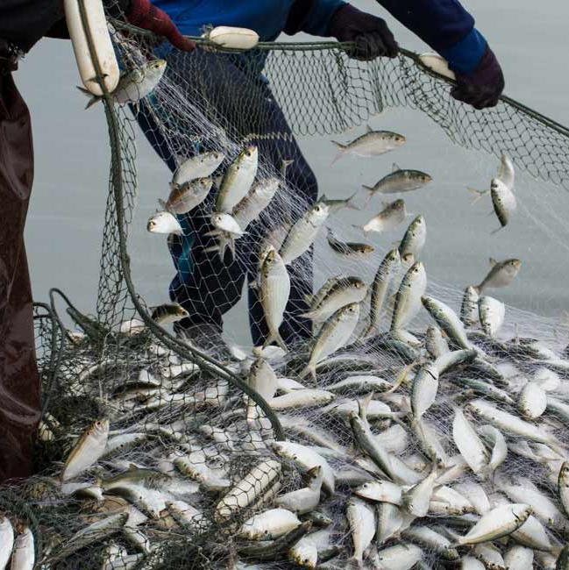

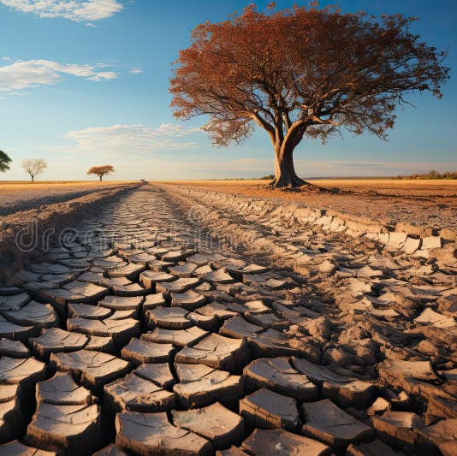
Where We Lack

Slide 10
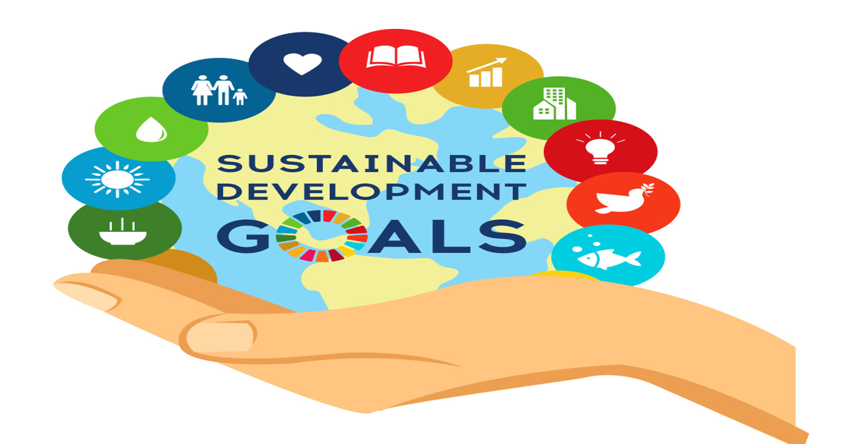
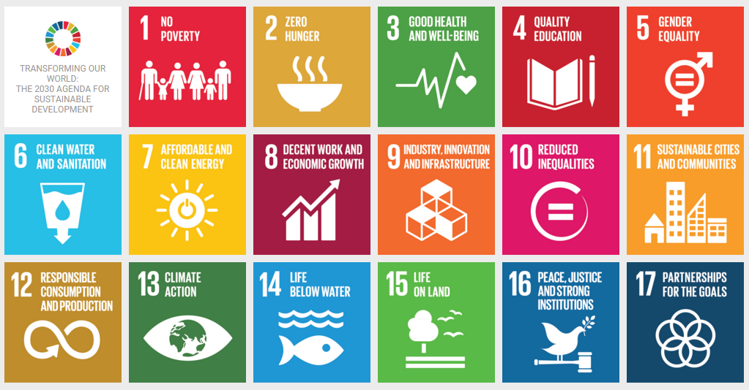
Our Goal?
We cannot continue using the resources at the current rate, as this way not enough would remain for future generations

Slide 11
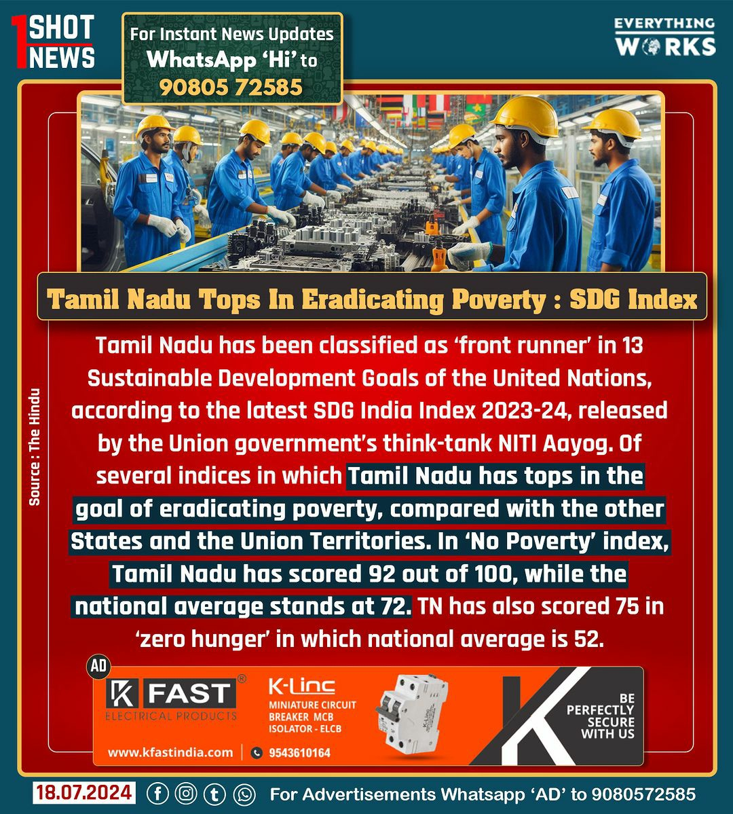
Where TN stands in SDG??

Slide 12
Scope of SDG
Sustainable development believes that operating within the right economic, social and environmental boundaries will create a truly sustainable health system, one that is fit for the future.
The scope of sustainable development is very wide, as it deals with areas like social, economic, environmental, and institutional dimensions.

Slide 13
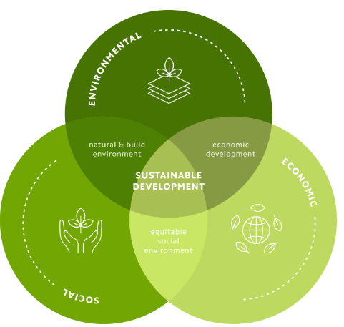
Scope of SDG
Environment Dimension
Practices that conserve resources, reduce pollution, and preserve ecosystems in the long term
Practices like renewable energy use, sustainable agriculture, and biodiversity protection.
Economic Dimension
Aims to create inclusive communities with fair access to basic needs, quality healthcare and education, promoting social equity while emphasizing the importance of justice, fairness, and equality for all individuals
Social Dimension
Prioritizes long-term planning, equitable wealth distribution, and stable growth through responsible business practices, encouraging innovation, and investment in sustainable industries

Slide 14
Scope of SDG
Institutional Dimension
Industry, Innovation and Infrastructure
Sound financial resources
Peace, justice and strong institutions
Sustainable cities and communities
SRM University Initiatives
Water and Air Research Initiatives: A Climate Change Perspective
Sustainable Technology Development
Consultancy and Outreach Programs
Capacity Building
SRM University aims to
Install Biogas plants
Install Solar panels
Installing LED based lighting
Reduce e-waste
Reduce average wastewater generation
Rainwater harvesting

Slide 15
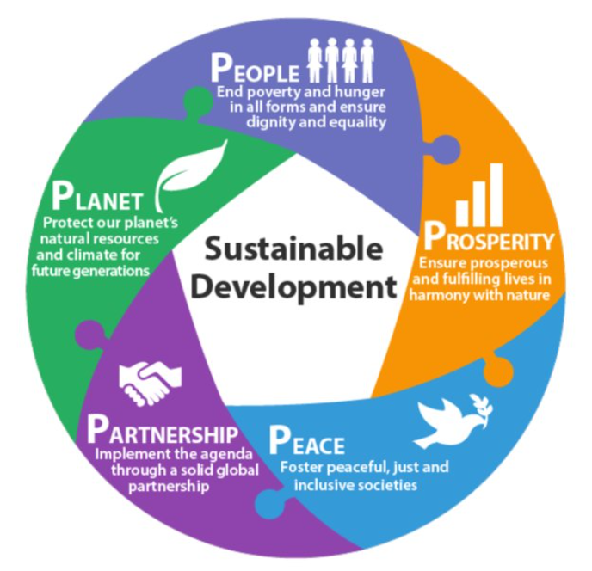
Elements of SDG : 5 P’s

Slide 16
Elements of SDG
People: Roles & Responsibilities
Eco-conscious Consumers
Individuals can make sustainable choices in their daily lives, such as reducing waste, conserving energy, and supporting eco-friendly businesses.
Community Advocates
Local communities can organize and participate in initiatives that promote sustainable practices, like urban gardening and renewable energy projects.
Responsible Citizens
Citizens can engage in the political process to support policies and leaders that prioritize environmental protection and social equity.

Slide 17
Elements of SDG
Government: Policies & Regulations
Legislation
Governments can enact laws and regulations that incentivize sustainable practices, such as carbon pricing, renewable energy targets, and waste management standards
Funding
Governments can provide financial support for research, development, and implementation of sustainable technologies and initiatives
Enforcement
Governments can enforce environmental laws and hold polluters accountable, ensuring compliance with sustainable development goals.

Slide 18
Elements of SDG
Investors: Financing Sustainable Initiatives
Green Bonds
Investors can finance green infrastructure, renewable energy projects, and other sustainable initiatives through the issuance of green bonds.
ESG Funds
Investors can allocate capital to funds that prioritize environmental, social, and governance (ESG) factors, supporting companies with sustainable practices.
Impact Investing
Investors can directly invest in businesses and organizations that have a positive social and environmental impact.
Shareholder Advocacy
Investors can use their shareholder influence to push for more sustainable policies and practices at companies they invest in.

Slide 19
Elements of SDG
Industry: Sustainable Practices and Innovation
Renewable Energy
Businesses can adopt renewable energy sources, such as solar, wind, and geothermal, to reduce their carbon footprint
Circular Economy
Industries can implement circular economy principles, reusing, recycling, and repurposing materials to minimize waste
Sustainable Supply Chains
Companies can work with their suppliers to ensure sustainable practices throughout their supply chain, from sourcing to distribution

Slide 20
Elements of SDG
Judiciary: Enforcing Environmental Laws
Adjudication
The judiciary plays a crucial role in interpreting and applying environmental laws, ensuring compliance and accountability
Balancing Interests
Courts must weigh the competing interests of economic development and environmental protection, upholding the principles of sustainable development
Enforcement
The judiciary can impose penalties and take enforcement actions against individuals and organizations that violate environmental regulations

Slide 21
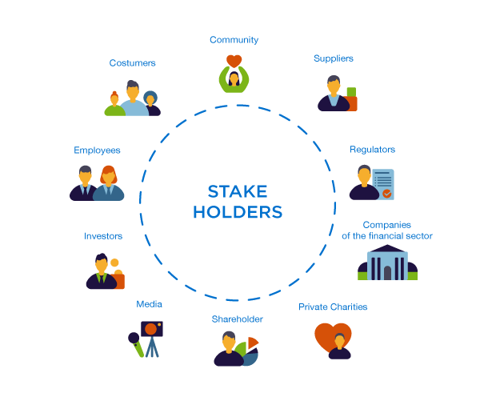
Stakeholders of SDB

Slide 22

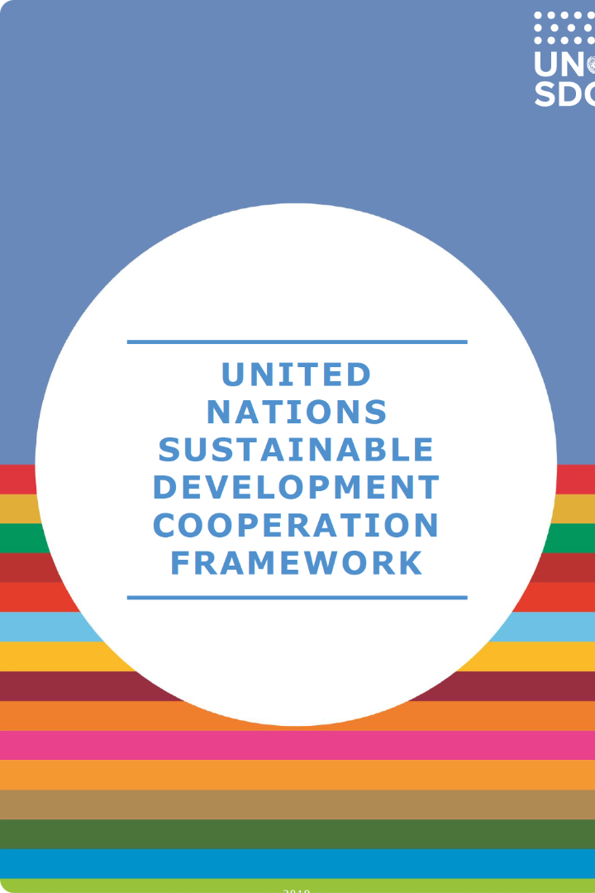
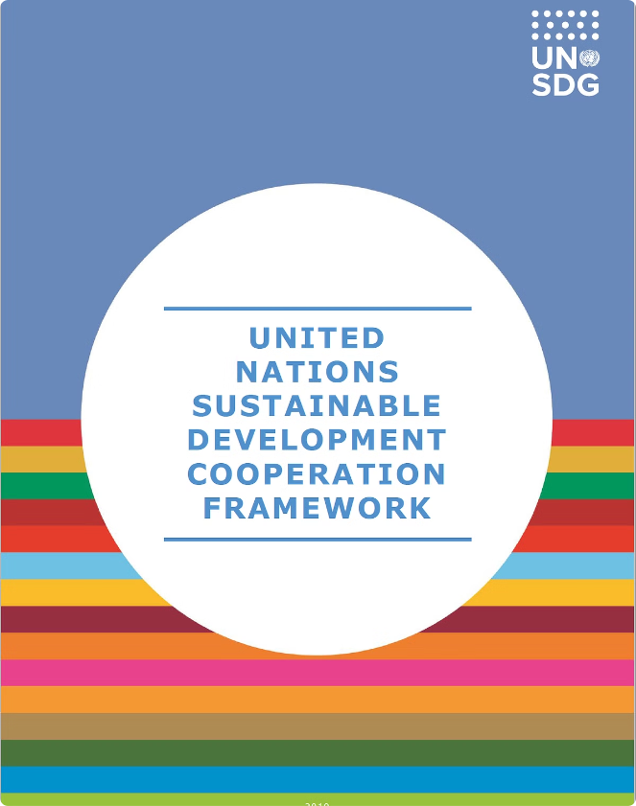
Conclusion: Collaborative Efforts for a Sustainable Future
Stakeholder
Key Role
People
Eco-conscious consumers, community advocates, responsible citizens
Government
Enacting policies, providing funding, enforcing regulations
Investors
Financing sustainable initiatives, advocating for change
Industry
Adopting sustainable practices, driving innovation
Judiciary
Interpreting laws, balancing interests, enforcing compliance
International Organizations
Establishing global frameworks, providing funding, building capacity
Sustainable development requires the collective efforts of all stakeholders, working together to address environmental, social, and economic challenges. By aligning their roles and responsibilities, we can create a more sustainable future for generations to come.

Slide 23
International Organizations: Promoting Global Sustainability
Policymaking
Capacity Building
International organizations, such as the United Nations, can establish global frameworks and agreements that guide national policies on sustainable development
They can also help build the capacity of local governments and communities to address environmental and social challenges
Funding
These organizations can provide financial assistance and technical support to developing countries for implementing sustainable initiatives

